Slide 1

A PERSONAL TRAINER APP TO SELF-TRAIN AND IMPROVE PRESENTATION SKILLS
21_22-J 02

Slide 2


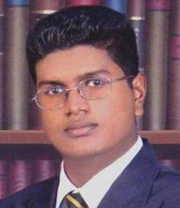
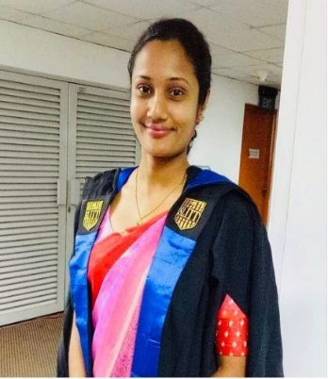
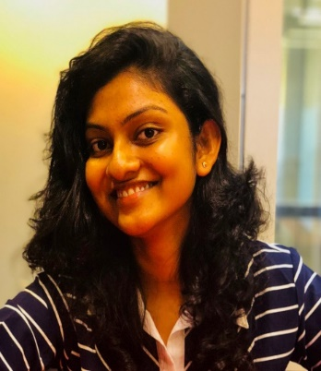
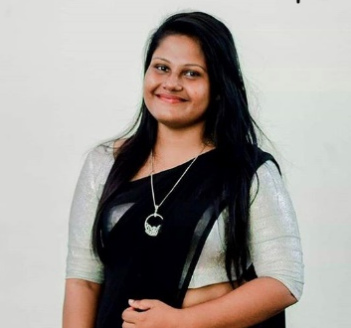



OUR TEAM
Dr. Shyam Mehraaj
Supervisor
Ms. Samanthi Siriwardene
Co-Supervisor
Ms. Veerandi Kulasekara
External Supervisor
IT18205152
Shehara A.K.G.H.
IT18229912
Wanigasinghe N.T.
IT18227750
Wandana R.A.K.
IT17535090
Wedage C.V.

Slide 3
INTRODUCTION
The goal of doing a presentation is to attract the attention of the audience through a good delivery.
A good presentation should be written and delivered in error-free and comprehensible English, and the presenter should look well-prepared and rehearsed.

Slide 4
INTRODUCTION CONT.
People are accustomed to practicing presentations beforehand, preferably with a friend, roommate, or teammate who will listen.
The proposed system “Presently” will self-evaluate the presentation skills of an individual.

Slide 5

Is there a mechanism in place to evaluate presentation skills
in advance?

Slide 6
RESEARCH PROBLEM
Audio analyzing - Pronunciation & vocabulary errors
Audio analyzing - Mis match & match of topic tone
Video analyzing - Emotion Detection
Content analyzing - Slide quality

Slide 7


MAIN OBJECTIVE
To develop a Mobile Responsive Web Application to evaluate the presentation skills.

Slide 8
SUB OBJECTIVES
To provide a user with incorrect pronunciation and vocabulary mistakes and to detect the user what emotions and enhancements used to present the story.
To detect user, the match or mismatch between topic tone and emotions used to present the story.
To check the grammar and spellings in presentation slides
To suggest the user how to attract audience effectively by analyzing slides for accuracy of content and aesthetics using computer vision and rules of design-best-practices.

Slide 9
METHODOLOGY
The user can upload the recorded video or audio and the presentation slides.
The system will extract the audio file and will analyze them separately.
Using the extracted audio file, system will check for any vocabulary and pronunciations errors.
The system will check for match and mismatch between the topic tone.
Using the extracted video file, system will check the emotions and the body language of the speaker.
With the uploaded slides the system will analyze the accuracy of content and aesthetics.

Slide 10
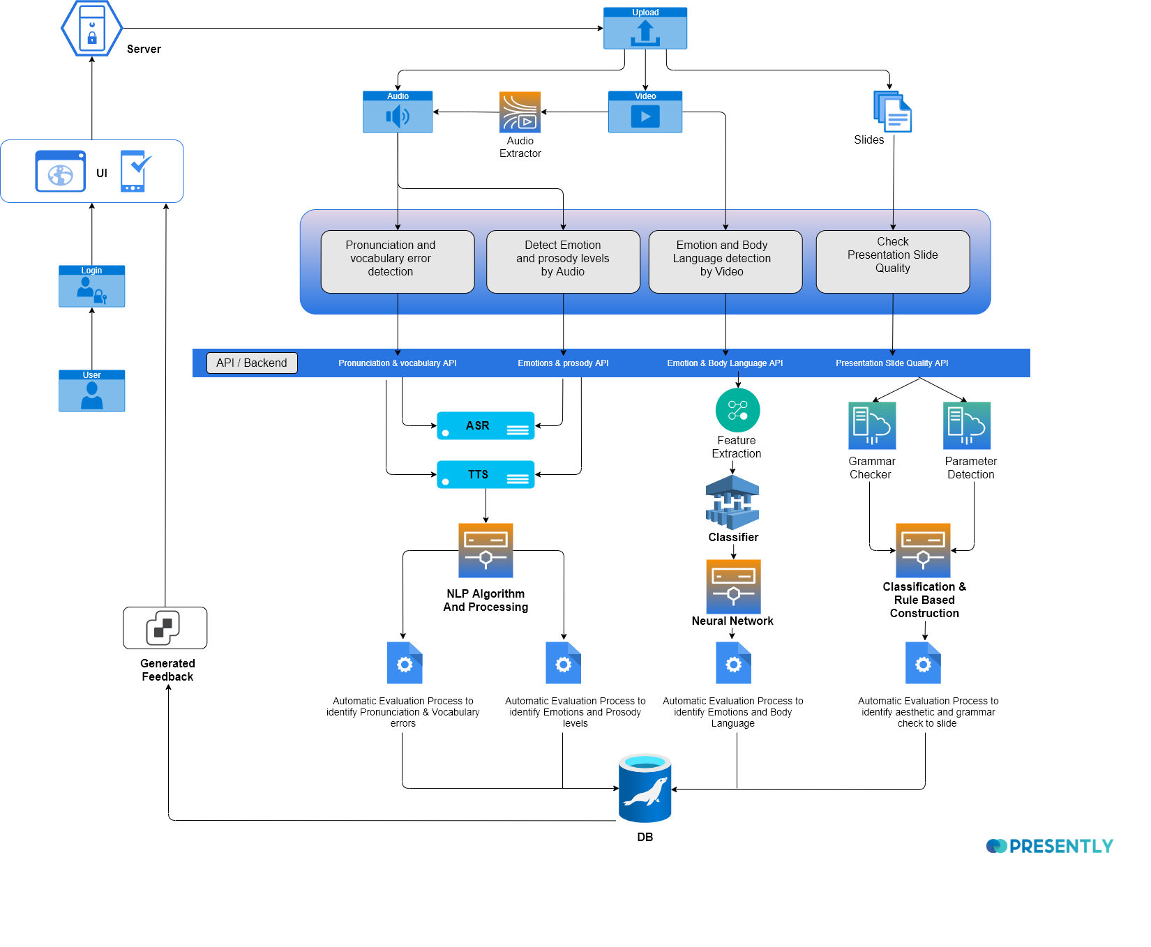
SYSTEM
OVERVIEW

Slide 11
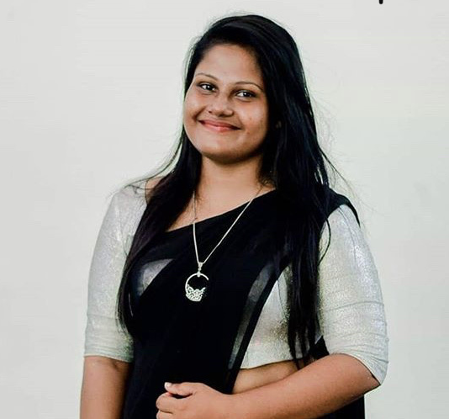
IT18205152 | Shehara A.K.G.H
Specializing in Software Engineering
Provide incorrect pronunciation and vocabulary mistakes

Slide 12
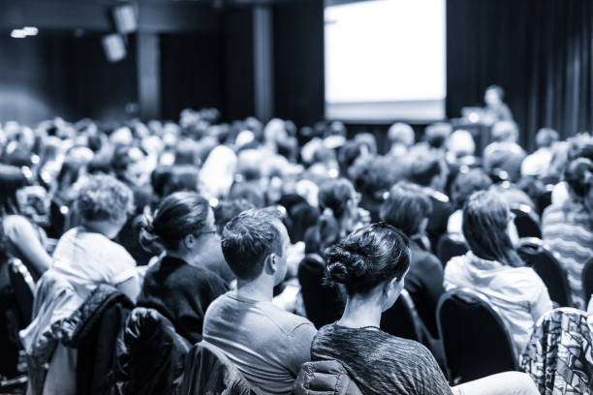
BACKGROUND
Rehearse before the presentation.
For effective communication, everyone should have a good vocabulary & correct pronunciation
IT18205152 | Shehara A.K.G.H. | 21_22-J 02

Slide 13

RESEARCH QUESTION
Identifying possible pronunciation issues that could arise throughout the presentation
Evaluation of grammatical mistakes in enhancing the audience's understanding of the presentation
IT18205152 | Shehara A.K.G.H. | 21_22-J 02

Slide 14
OBJECTIVES
Detection of the pronunciation mistakes that will occur during the presentation.
Analyzation of vocabulary errors to make the presentation more accurate to the audience.
IT18205152 | Shehara A.K.G.H. | 21_22-J 02

Slide 15

RESEARCH GAP
 | Murmuring Sound Detection | Pronunciation Level detection | Teach to pronounce | Vocabulary mistake detection | Personalized system
 | √ | √ | √ | √ | √
A development of EFL presentation skills [1] |  | √
Developing research presentation skills [2] |  | √
Developing oral presentation skills [3] |  | √
Improving English Pronunciation[4] |  | √ | √
Speech Coach [5] | √ | √ |  |  | √
A detailed survey on large vocabulary[6] |  |  |  | √
Automatic Correction System [7] | √ | √
Frequency based spell checking and rule-based grammar checking [8] |  | √ |  | √
An efficient system for grammatical error correction on mobile devices [9] |  |  |  | √ | √
A precise evaluation method of prosodic quality of non-native speakers [10] |  | √
Speech Processing for Language Learning [11] |  | √ | √
A Context-Sensitive Real-Time Spell Checker [12] | √ | √
An empirical evaluation of the English File Pronunciation app [13] |  | √ | √ |  | √
Adaptation of speech recognition vocabularies [14] | √ |  |  | √
IT18205152 | Shehara A.K.G.H. | 21_22-J 02

Slide 16

RESEARCH METHODOLOGY
IT18205152 | Shehara A.K.G.H. | 21_22-J 02

Slide 17
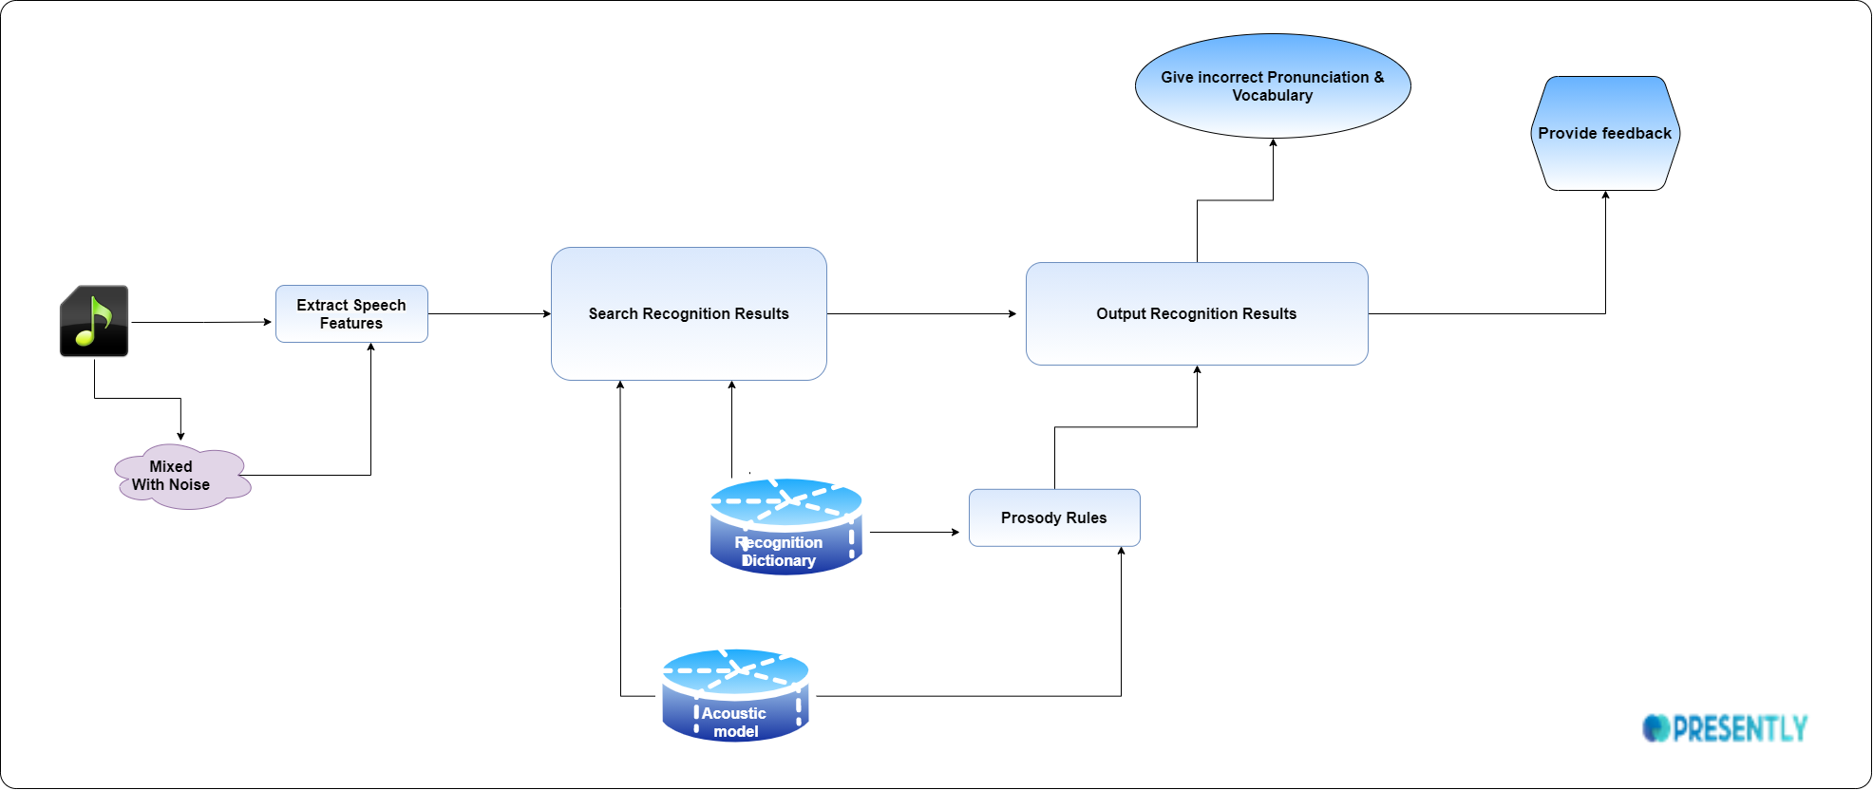
SYSTEM DIAGRAM
IT18205152 | Shehara A.K.G.H. | 21_22-J 02

Slide 18




TOOLS & TECHNOLOGIES
IT18205152 | Shehara A.K.G.H. | 21_22-J 02

Slide 19
FUNCTIONAL REQUIREMENTS
NON-FUNCTIONAL REQUIREMENTS
The system will check for pronunciation and vocabulary issues using the audio file.
The system will provide feedback on the presenter's pronunciation and vocabulary errors.
Performance
Correctness
Availability
IT18205152 | Shehara A.K.G.H. | 21_22-J 02

Slide 20
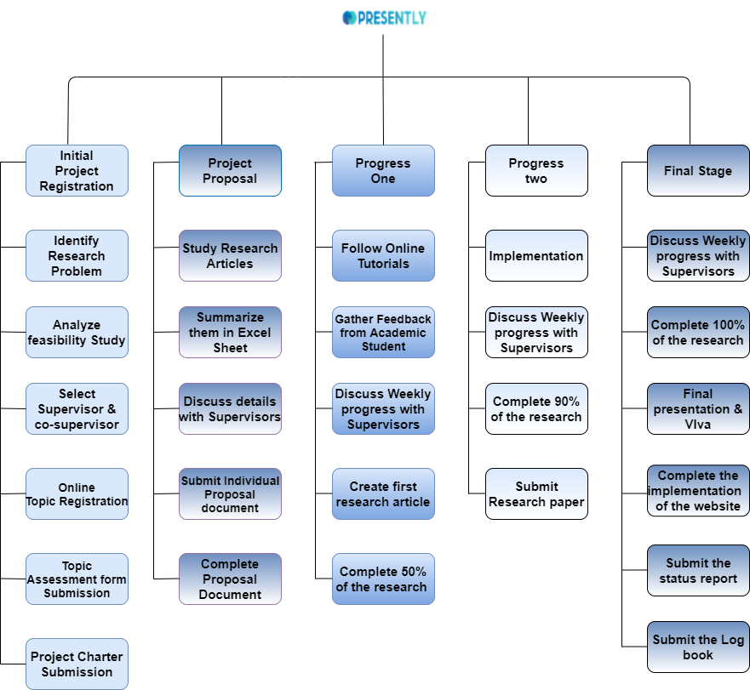
WORK BREAKDOWN CHART
IT18205152 | Shehara A.K.G.H. | 21_22-J 02

Slide 21
REFERENCES
[1] S. Bosley and B. Anuyahong, "A development of EFL presentation skills by using the communicative approach for university students," 2018 5th International Conference on Business and Industrial Research (ICBIR), 2018, pp. 522-525, doi: 10.1109/ICBIR.2018.8391253.
[2] J. Shi, "Developing research presentation skills for international conferences," Proceedings of the 2013 International Conference on Advanced Mechatronic Systems, 2013, pp. 406-411, doi: 10.1109/ICAMechS.2013.6681817.
[3] Z. Ma, Y. Wang and X. Guan, "Developing oral presentation skills through formative self- and peer-assessment in the context of China," 2019 Eighth International Conference on Educational Innovation through Technology (EITT), 2019, pp. 199-205, doi: 10.1109/EITT.2019.00046.
[4] M. Li, M. Han, Z. Chen, Y. Mo, X. Chen and X. Liu, "Improving English Pronunciation Via Automatic Speech Recognition Technology," 2017 International Symposium on Educational Technology (ISET), 2017, pp. 224-228, doi: 10.1109/ISET.2017.58.
[5] A. Deshpande, R. Pandharkar and S. Deolekar, "Speech Coach: A framework to evaluate and improve speech delivery," 2020 4th International Conference on Computer, Communication and Signal Processing (ICCCSP), 2020, pp. 1-5, doi: 10.1109/ICCCSP49186.2020.9315267.
[6] P. Vanajakshi and M. Mathivanan, "A detailed survey on large vocabulary continuous speech recognition techniques," 2017 International Conference on Computer Communication and Informatics (ICCCI), 2017, pp. 1-7, doi: 10.1109/ICCCI.2017.8117755.
[7] Y. Xin, "The Design of Automatic Correction System for Spoken English Pronunciation Errors Based on Phonemes," 2019 6th International Conference on Dependable Systems and Their Applications (DSA), 2020, pp. 247-254, doi: 10.1109/DSA.2019.00038.
IT18205152 | Shehara A.K.G.H. | 21_22-J 02

Slide 22
[8] S. P. Singh, A. Kumar, L. Singh, M. Bhargava, K. Goyal and B. Sharma, "Frequency based spell checking and rule based grammar checking," 2016 International Conference on Electrical, Electronics, and Optimization Techniques (ICEEOT), 2016, pp. 4435-4439, doi: 10.1109/ICEEOT.2016.7755557.
[9] S. V. Gothe, S. Dogra, M. Chandra, C. Sanchi and B. R. K. Raja, "An efficient system for grammatical error correction on mobile devices," 2021 IEEE 15th International Conference on Semantic Computing (ICSC), 2021, pp. 147-154, doi: 10.1109/ICSC50631.2021.00034.
[10] H. Prafianto, T. Nose and A. Ito, "A precise evaluation method of prosodic quality of non-native speakers using average voice and prosody substitution," 2016 International Conference on Audio, Language and Image Processing (ICALIP), 2016, pp. 208-212, doi: 10.1109/ICALIP.2016.7846620.
[11] Bogach, Natalia & Boitsova, Elena & Chernonog, Sergey & Lamtev, Anton & Lesnichaya, Maria & Lezhenin, Iurii & Novopashenny, Andrey & Svechnikov, Roman & Tsikach, Daria & Vasiliev, Konstantin & Pyshkin, Evgeny & John, Blake. (2021). Speech Processing for Language Learning: A Practical Approach to Computer-Assisted Pronunciation Teaching. Electronics. 10. 235. 10.3390/electronics10030235.
[12] P. Gupta, "A Context-Sensitive Real-Time Spell Checker with Language Adaptability," 2020 IEEE 14th International Conference on Semantic Computing (ICSC), 2020, pp. 116-122, doi: 10.1109/ICSC.2020.00023.
[13] Fouz-González, Jonas. (2020). Using apps for pronunciation training: An empirical evaluation of the English File Pronunciation app. Language, Learning and Technology. 24.
[14] Denis Jouvet, David Langlois, Mohamed Menacer, Dominique Fohr, Odile Mella, et al.. Adaptation of speech recognition vocabularies for improved transcription of YouTube videos. Journal of International Science and General Applications, ISGA, 2018, 1 (1), pp.1-9. ffhal-01873801f
IT18205152 | Shehara A.K.G.H. | 21_22-J 02

Slide 23
[15] Cavus, N. (2016). Development of an Intelligent Mobile Application for Teaching English Pronunciation. In Procedia Computer Science (Vol. 102, pp. 365–369). Elsevier B.V. https://doi.org/10.1016/j.procs.2016.09.413
[16] Modeling, P.S., and St, N.C. (2019). IMPROVING END-TO-END SPEECH RECOGNITION WITH Hainan Xu , Shuoyang Ding , Shinji Watanabe Center for Language and Speech Processing ,. Ieee 7110–7114.
[17] Bashori, M., van Hout, R., Strik, H., & Cucchiarini, C. (2021). Effects of ASR-based websites on EFL learners’ vocabulary, speaking anxiety, and language enjoyment. System, 99. https://doi.org/10.1016/j.system.2021.102496
[18] Mukherjee, P., Santra, S., Bhowmick, S., Paul, A., Chatterjee, P., & Deyasi, A. (2018). Development of GUI for text-to-speech recognition using natural language processing. In 2018 2nd International Conference on Electronics, Materials Engineering and Nano-Technology, IEMENTech 2018. Institute of Electrical and Electronics Engineers Inc. https://doi.org/10.1109/IEMENTECH.2018.8465238
IT18205152 | Shehara A.K.G.H. | 21_22-J 02

Slide 24

IT18229912 | Wanigasinghe N.T
Specializing in Software Engineering
Suggest the match or mismatch between topic tone and emotions

Slide 25
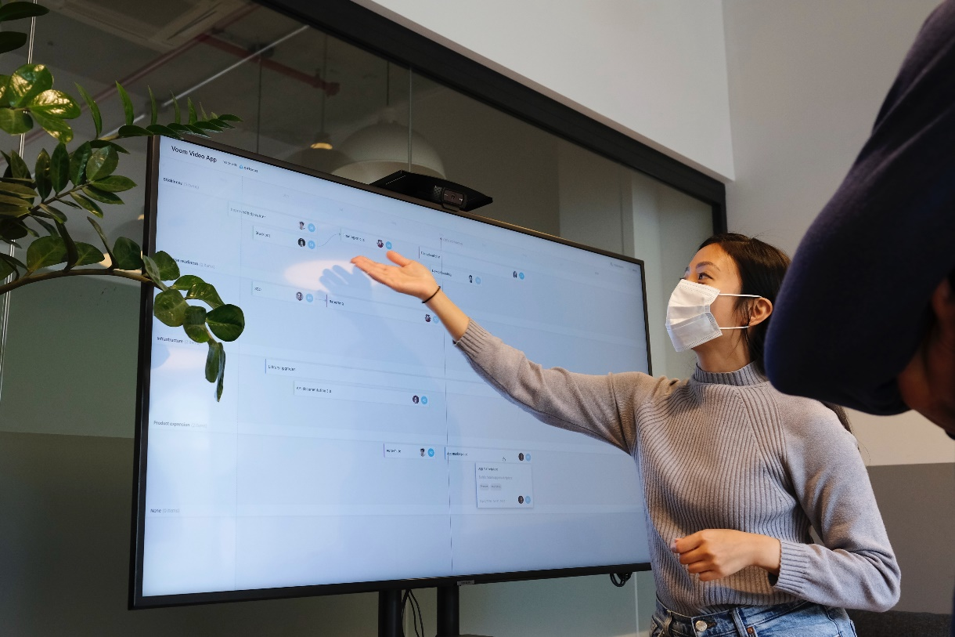
BACKGROUND
Should maintain tone, pitch and emotions controlled.
Performs the emotions and prosody naturalness of the presenter.
IT18229912 | Wanigasinghe N.T. | 21_22-J 02

Slide 26

RESEARCH QUESTION
Inability of finding the match and mis match between the tone of the speaker.
Void of a system to detect the emotions during the presentation.
IT18229912 | Wanigasinghe N.T. | 21_22-J 02

Slide 27
OBJECTIVES
Implement more accurate and intelligent application to identify presenters’ emotion and prosody levels.
Analyse the match or mismatch between topic tone and emotions used to present the story.
IT18229912 | Wanigasinghe N.T. | 21_22-J 02

Slide 28

RESEARCH GAP
 | Emotion detection using Audio | Prosody detection using Audio | Fluency, murmuring sound detection | Personalized system
Prosody Features from Normal and Stressed Regions for Emotion Recognition [3]
Narrow-focus word-stress in speech synthesis [9]
Prosody transplantation for TTS: Unit granularity, context, and prosody styles [13]
Speech Emotion Recognition Using Deep Learning on audio recordings [14]
Speech Emotion Recognition Based on Deep Learning and Kernel Nonlinear PSVM [11]
Application of prosody modification for Speech Recognition [5]
Emotional prosody analysis on human voices [4]
IT18229912 | Wanigasinghe N.T. | 21_22-J 02

Slide 29
RESEARCH METHODOLOGY
IT18229912 | Wanigasinghe N.T. | 21_22-J 02

Slide 30
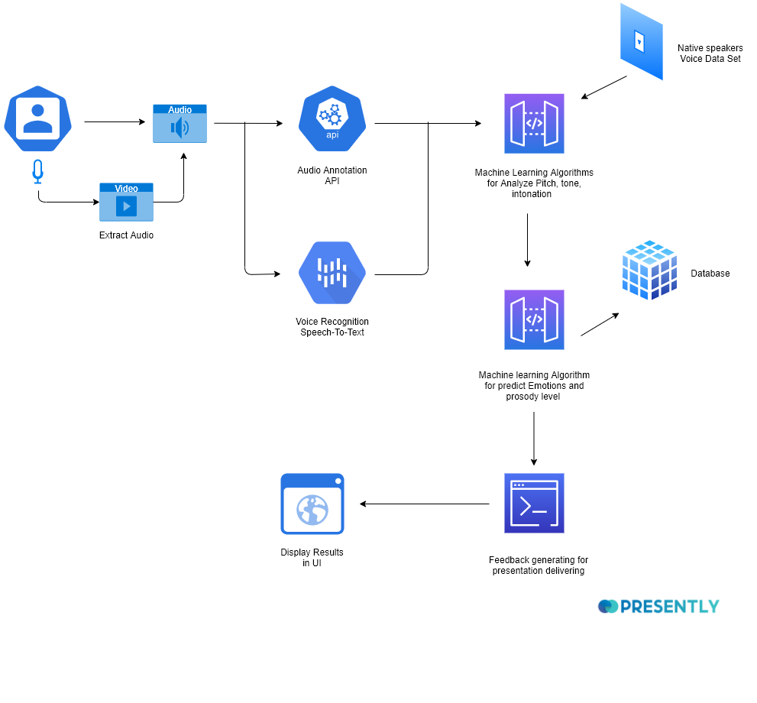
SYSTEM DIAGRAM
IT18229912 | Wanigasinghe N.T. | 21_22-J 02

Slide 31
TOOLS & TECHNOLOGIES
IT18229912 | Wanigasinghe N.T. | 21_22-J 02

Slide 32
FUNCTIONAL REQUIREMENTS
NON-FUNCTIONAL REQUIREMENTS
Using the audio analysis system will provide the tonality and prosody errors.
Performance
Correctness
Availability
IT18229912 | Wanigasinghe N.T. | 21_22-J 02

Slide 33
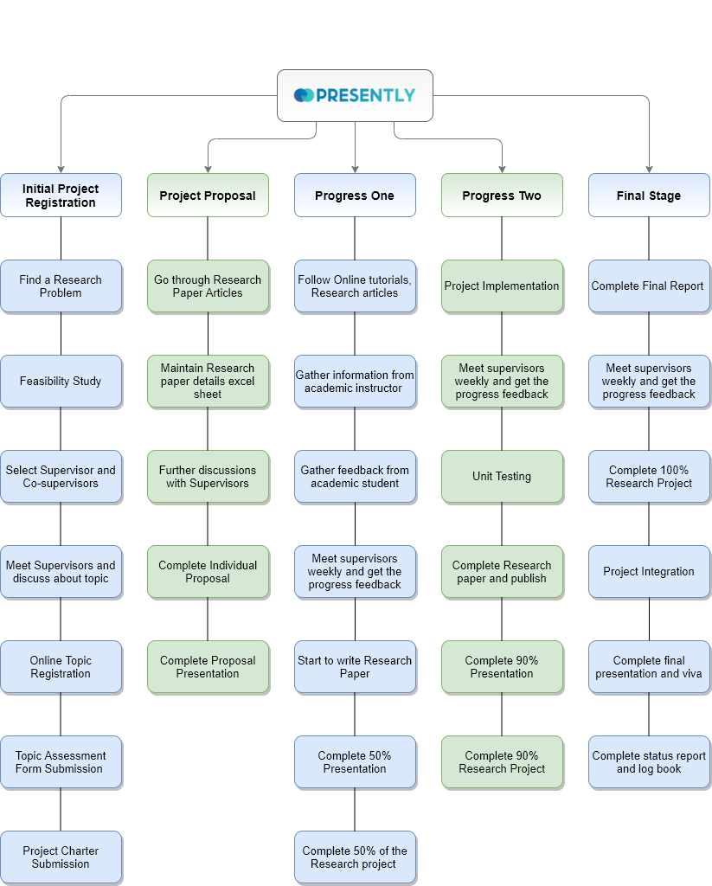

WORK BREAKDOWN
CHART
IT18229912 | Wanigasinghe N.T. | 21_22-J 02

Slide 34
REFERENCES
[1] V. V. V. Raju, H. K. Vydana, S. V. Gangashetty and A. K. Vuppala, "Importance of non-uniform prosody modification for speech recognition in emotion conditions," 2017 Asia-Pacific Signal and Information Processing Association Annual Summit and Conference (APSIPA ASC), 2017, pp. 573-576, doi: 10.1109/APSIPA.2017.8282109.
[2] B. Sisman, G. Lee, H. Li and K. C. Tan, "On the analysis and evaluation of prosody conversion techniques," 2017 International Conference on Asian Language Processing (IALP), 2017, pp. 44-47, doi: 10.1109/IALP.2017.8300542.
[3] V. V. Raju V., K. Gurugubelli, K. N. R. K. R. Alluri and A. Kumar Vuppala, "Differenced Prosody Features from Normal and Stressed Regions for Emotion Recognition," 2018 5th International Conference on Signal Processing and Integrated Networks (SPIN), 2018, pp. 821-825, doi: 10.1109/SPIN.2018.8474265.
[4] N. Ang, D. Bein, D. Dao, L. Sanchez, J. Tran and N. Vurdien, "Emotional prosody analysis on human voices," 2018 IEEE 8th Annual Computing and Communication Workshop and Conference (CCWC), 2018, pp. 737-741, doi: 10.1109/CCWC.2018.8301691.
[5] V. V. V. Raju, P. Gangamohan, S. V. Gangashetty and A. k. Vuppala, "Application of prosody modification for Speech Recognition in different Emotion conditions," 2016 IEEE Region 10 Conference (TENCON), 2016, pp. 951-954, doi: 10.1109/TENCON.2016.7848145.
[6] R. Fu, J. Tao, Z. Wen, J. Yi, T. Wang and C. Qiang, "Bi-Level Style and Prosody Decoupling Modeling for Personalized End-to-End Speech Synthesis," ICASSP 2021 - 2021 IEEE International Conference on Acoustics, Speech and Signal Processing (ICASSP), 2021, pp. 6568-6572, doi: 10.1109/ICASSP39728.2021.9414422.
[7] C. -M. Chien and H. -y. Lee, "Hierarchical Prosody Modeling for Non-Autoregressive Speech Synthesis," 2021 IEEE Spoken Language Technology Workshop (SLT), 2021, pp. 446-453, doi: 10.1109/SLT48900.2021.9383629.
.
IT18229912 | Wanigasinghe N.T. | 21_22-J 02

Slide 35
[8] H. Prafianto, T. Nose and A. Ito, "A precise evaluation method of prosodic quality of non-native speakers using average voice and prosody substitution," 2016 International Conference on Audio, Language and Image Processing (ICALIP), 2016, pp. 208-212, doi: 10.1109/ICALIP.2016.7846620
[9] A. Kamat, A. Krishnamurthy, D. N. Krishna and V. Ramasubramanian, "Prosodic differential for narrow-focus word-stress in speech synthesis," 2017 Twenty-third National Conference on Communications (NCC), 2017, pp. 1-6, doi: 10.1109/NCC.2017.8077132.
[10] L. Matsane, A. Jadhav and R. Ajoodha, "The use of Automatic Speech Recognition in Education for Identifying Attitudes of the Speakers," 2020 IEEE Asia-Pacific Conference on Computer Science and Data Engineering (CSDE), 2020, pp. 1-7, doi: 10.1109/CSDE50874.2020.9411528.
[11] Z. HAN and J. WANG, "Speech Emotion Recognition Based on Deep Learning and Kernel Nonlinear PSVM," 2019 Chinese Control and Decision Conference (CCDC), 2019, pp. 1426-1430, doi: 10.1109/CCDC.2019.8832414.
[12] H. Koo, S. Jeong, S. Yoon and W. Kim, "Development of Speech Emotion Recognition Algorithm using MFCC and Prosody," 2020 International Conference on Electronics, Information, and Communication (ICEIC), 2020, pp. 1-4, doi: 10.1109/ICEIC49074.2020.9051281.
[13] M. G. K. Noor Fathima et al., "Phonetically conditioned prosody transplantation for TTS: Unit granularity, context and prosody styles," 2016 Conference of The Oriental Chapter of International Committee for Coordination and Standardization of Speech Databases and Assessment Techniques (O-COCOSDA), 2016, pp. 99-104, doi: 10.1109/ICSDA.2016.7918992.
[14] S. Suganya and E. Y. A. Charles, "Speech Emotion Recognition Using Deep Learning on audio recordings," 2019 19th International Conference on Advances in ICT for Emerging Regions (ICTer), 2019, pp. 1-6, doi: 10.1109/ICTer48817.2019.9023737.
[15] P. Robitaille, S. Trempe, P. Gournay and R. Lefebvre, "On the influence of quantization on the identifiability of emotions from voice coding parameters," 2016 IEEE International Conference on Acoustics, Speech and Signal Processing (ICASSP), 2016, pp. 5950-5954, doi: 10.1109/ICASSP.2016.7472819.
IT18229912 | Wanigasinghe N.T. | 21_22-J 02

Slide 36

IT18227750 | Wandana R.A.K
Specializing in Data Science
Suggest the user what emotions and enhancements used to present the story

Slide 37
BACKGROUND
Emotions, body language, eye contact, maintaining a confident posture is important.
Speakers need to engage more with the audience and be confident during the presentation.
IT18227750 | Wandana R.A.K. | 21_22-J 02

Slide 38
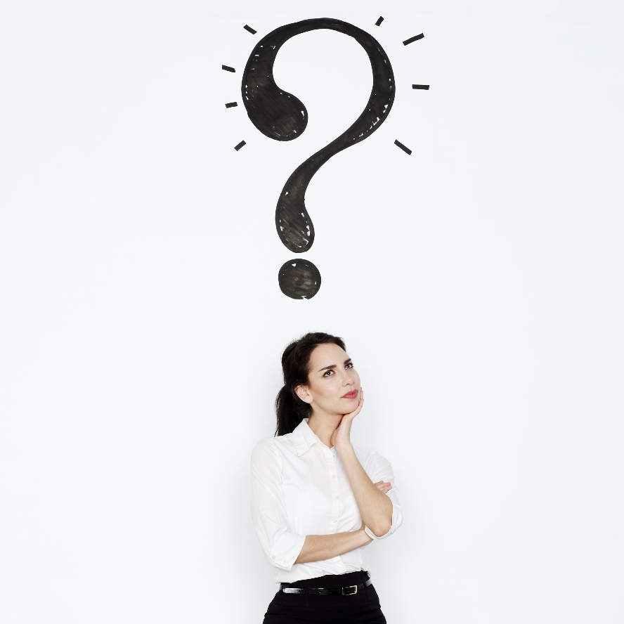
RESEARCH QUESTION
Inability to self-evaluate presenting emotions and body language postures due to a lack of an appropriate method or instrument.
IT18227750 | Wandana R.A.K. | 21_22-J 02

Slide 39
OBJECTIVES
To correctly extract the related emotions and body language postures.
Check whether the emotions and body language are presentation related.
IT18227750 | Wandana R.A.K. | 21_22-J 02

Slide 40

RESEARCH GAP
Features | EmoCo [1] | Facial Expression Recognition of Instructor [8] | Emotions in software practice: presentation vs. coding [9] | Multimodal based Emotion Recognition challenge [10]
Happy | √ | √ | √ | X | √
Sad | √ | X | √ | X | √
Anger | √ | X | √ | X | √
Surprise | √ | √ | √ | X | √
Fear | √ | X | √ | X | √
Confidence | X | √ | X | X | √
Neutral | √ | √ | X | X | √
Nervousness | X | X | X | X | √
Body Language | X | X | X | √ | √
Providing Feedbacks | X | X | X | X | √
Mobile Responsive Application | X | X | X | X | √
IT18227750 | Wandana R.A.K. | 21_22-J 02

Slide 41
RESEARCH METHODOLOGY
IT18227750 | Wandana R.A.K. | 21_22-J 02

Slide 42
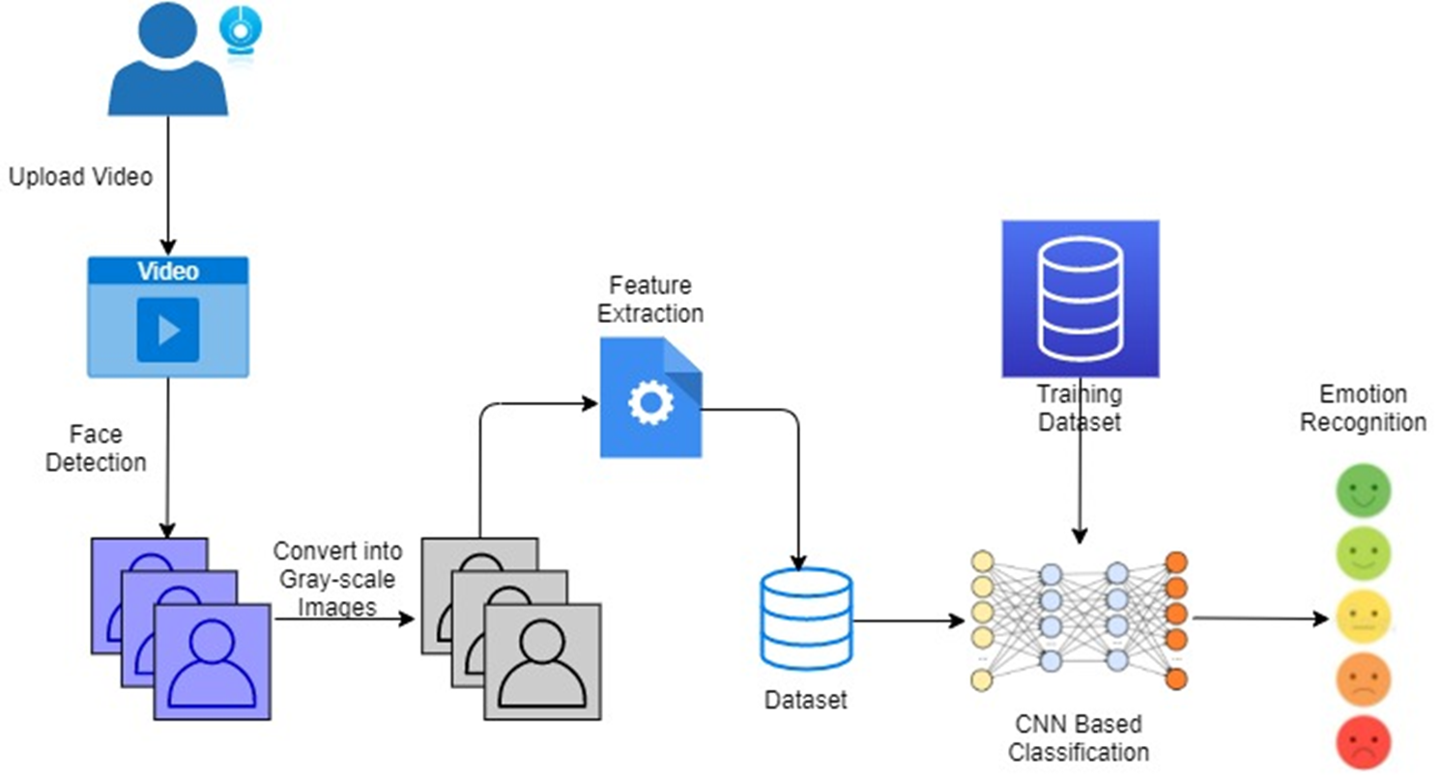
SYSTEM DIAGRAM
IT18227750 | Wandana R.A.K. | 21_22-J 02

Slide 43



TOOLS & TECHNOLOGIES
IT18227750 | Wandana R.A.K. | 21_22-J 02

Slide 44
FUNCTIONAL REQUIREMENTS
NON-FUNCTIONAL REQUIREMENTS
System will extract features from the uploaded video.
Performance
Correctness
Using video analysis system will detect presenters’ emotions and body gestures.
Availability
IT18227750 | Wandana R.A.K. | 21_22-J 02

Slide 45
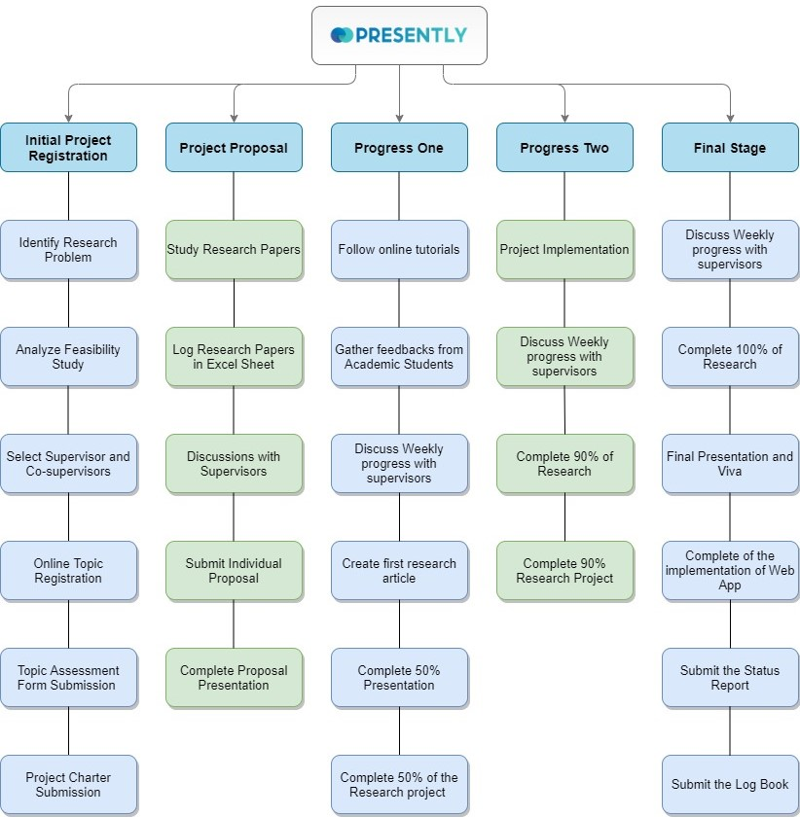
WORK BREAKDOWN CHART
IT18227750 | Wandana R.A.K. | 21_22-J 02

Slide 46
REFERENCES
[1] H. Zeng et al., “EmoCo: Visual analysis of emotion coherence in presentation videos,” IEEE Trans. Vis. Comput. Graph., vol. 26, no. 1, pp. 927–937, 2020, doi: 10.1109/TVCG.2019.2934656.
[2] I. A. Adeyanju, E. O. Omidiora, and O. F. Oyedokun, “Performance evaluation of different support vector machine kernels for face emotion recognition,” IntelliSys 2015 - Proc. 2015 SAI Intell. Syst. Conf., pp. 804–806, 2015, doi: 10.1109/IntelliSys.2015.7361233.
[3] B. T. Nguyen, M. H. Trinh, T. V. Phan, and H. D. Nguyen, “An efficient real-Time emotion detection using camera and facial landmarks,” 7th Int. Conf. Inf. Sci. Technol. ICIST 2017 - Proc., pp. 251–255, 2017, doi: 10.1109/ICIST.2017.7926765.
[4] Madhura Prakash, Aman Kumar, Anmol Saxena, and Somil Agrawal, Twinkle Singh, “Audience Feedback Analysis using Emotion Recognition,” Int. J. Eng. Res., vol. V9, no. 05, pp. 1090–1094, 2020, doi: 10.17577/ijertv9is050717.
[5] V. R. Guttha, H. K. Kondakindi, and V. Bhatti, “Automated feedback generation system using facial emotion recognition,” 2018 3rd IEEE Int. Conf. Recent Trends Electron. Inf. Commun. Technol. RTEICT 2018 - Proc., pp. 975–981, 2018, doi: 10.1109/RTEICT42901.2018.9012630.
[6] S. J. Goyal, A. K. Upadhyay, and R. S. Jadon, “Facial emotion recognition through hand gesture and its position surrounding the face,” Int. J. Eng. Adv. Technol., vol. 8, no. 3, pp. 441–444, 2019.
[7] S. L. Happy, A. Dasgupta, P. Patnaik, and A. Routray, “Automated alertness and emotion detection for empathic feedback during E-learning,” Proc. - 2013 IEEE 5th Int. Conf. Technol. Educ. T4E 2013, pp. 47–50, 2013, doi: 10.1109/T4E.2013.19.
[8] Y. K. Bhatti, A. Jamil, N. Nida, M. H. Yousaf, S. Viriri, and S. A. Velastin, “Facial Expression Recognition of Instructor Using Deep Features and Extreme Learning Machine,” Comput. Intell. Neurosci., vol. 2021, 2021, doi: 10.1155/2021/5570870.
[9] R. Colomo-Palacios, T. Samuelsen, and C. Casado-Lumbreras, “Emotions in software practice: Presentation vs. coding,” Proc. - 2019 IEEE/ACM 4th Int. Work. Emot. Aware. Softw. Eng. SEmotion 2019, no. Section II, pp. 23–28, 2019, doi: 10.1109/SEmotion.2019.00012.
IT18227750 | Wandana R.A.K. | 21_22-J 02

Slide 47
[10] G. Wei, L. Jian, and S. Mo, “Multimodal ( Audio , Facial and Gesture ) based Emotion Recognition challenge,” pp. 57–60.
[11] A. Revathy, P. Shanmugapriya, and V. Mohan, “Performance comparison of speaker and emotion recognition,” 2015 3rd Int. Conf. Signal Process. Commun. Networking, ICSCN 2015, pp. 3–8, 2015, doi: 10.1109/ICSCN.2015.7219844.
[12] T. M. W. Vithanawasam and B. G. D. A. Madhusanka, “Face and Upper-Body Emotion Recognition Using Service Robot’s Eyes in a Domestic Environment,” Proc. - IEEE Int. Res. Conf. Smart Comput. Syst. Eng. SCSE 2019, pp. 44–50, 2019, doi: 10.23919/SCSE.2019.8842658.
[13] C. Viegas, “Two Stage Emotion Recognition using Frame-level and Video-level Features,” Proc. - 2020 15th IEEE Int. Conf. Autom. Face Gesture Recognition, FG 2020, vol. 1, pp. 912–915, 2020, doi: 10.1109/FG47880.2020.00143.
[14] F. Noroozi, C. A. Corneanu, D. Kaminska, T. Sapinski, S. Escalera, and G. Anbarjafari, “Survey on Emotional Body Gesture Recognition,” IEEE Trans. Affect. Comput., vol. 12, no. 2, pp. 505–523, 2021, doi: 10.1109/TAFFC.2018.2874986.
[15] D. K. Bhadangkar, J. D. Pujari, and R. Yakkundimath, “Comparison of tuplet of techniques for facial emotion detection,” Proc. 4th Int. Conf. IoT Soc. Mobile, Anal. Cloud, ISMAC 2020, pp. 725–730, 2020, doi: 10.1109/I-SMAC49090.2020.9243439.
[16] M. Cui, J. Fang, and Y. Zhao, “Emotion recognition of human body’s posture in open environment,” Proc. 32nd Chinese Control Decis. Conf. CCDC 2020, pp. 3294–3299, 2020, doi: 10.1109/CCDC49329.2020.9164551.
[17] M. Singh, B. B. Naib, and A. K. Goel, “Facial Emotion Detection using Action Units,” no. September, pp. 1037–1041, 2020, doi: 10.1109/icces48766.2020.9137919.
[18] N. Gomez, “Facial Emotion Recognition Using Machine Learning Algorithms,” no. October, 2013.
IT18227750 | Wandana R.A.K. | 21_22-J 02

Slide 48

IT17535090 | Wedage C.V
Specializing in Data Science
Suggest the user how to attract audience effectively by analyzing slides for accuracy of content and aesthetics
IT17535090 | Wedage C.V. | 21_22-J 02

Slide 49
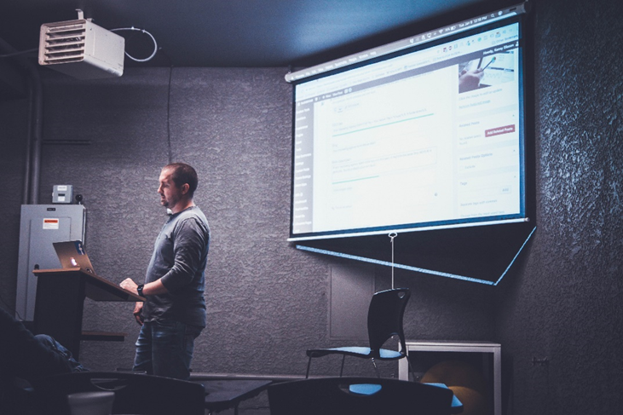
BACKGROUND
Slides keep an audience's attention during a presentation to provide additional supporting.
Checking the aesthetic quality of the slides and create textual error free quality slide.
IT17535090 | Wedage C.V. | 21_22-J 02

Slide 50
RESEARCH QUESTION
To create self-train web application to cater personal coach to check presentation slide quality by analyzing input pptx.
Detect mistakes by Checking the accuracy of the content using grammar checker.
IT17535090 | Wedage C.V. | 21_22-J 02

Slide 51
OBJECTIVES
Do the proofreading and check the presentation slides accuracy.
Aesthetic-aware slides to image synthesis.
As optional check the relevancy of the presentation topic with the content of the slides.
IT17535090 | Wedage C.V. | 21_22-J 02

Slide 52
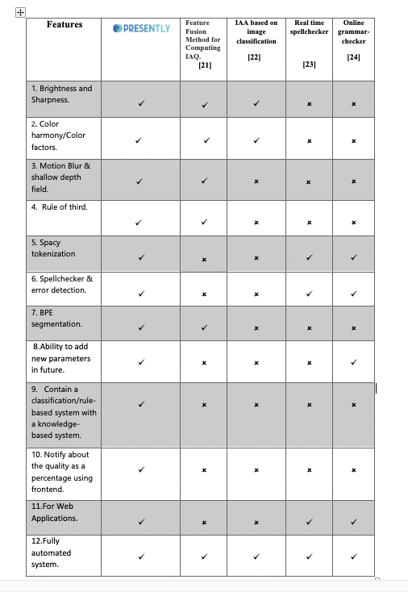
RESEARCH GAP
IT17535090 | Wedage C.V. | 21_22-J 02

Slide 53
RESEARCH METHODOLOGY
IT17535090 | Wedage C.V. | 21_22-J 02

Slide 54
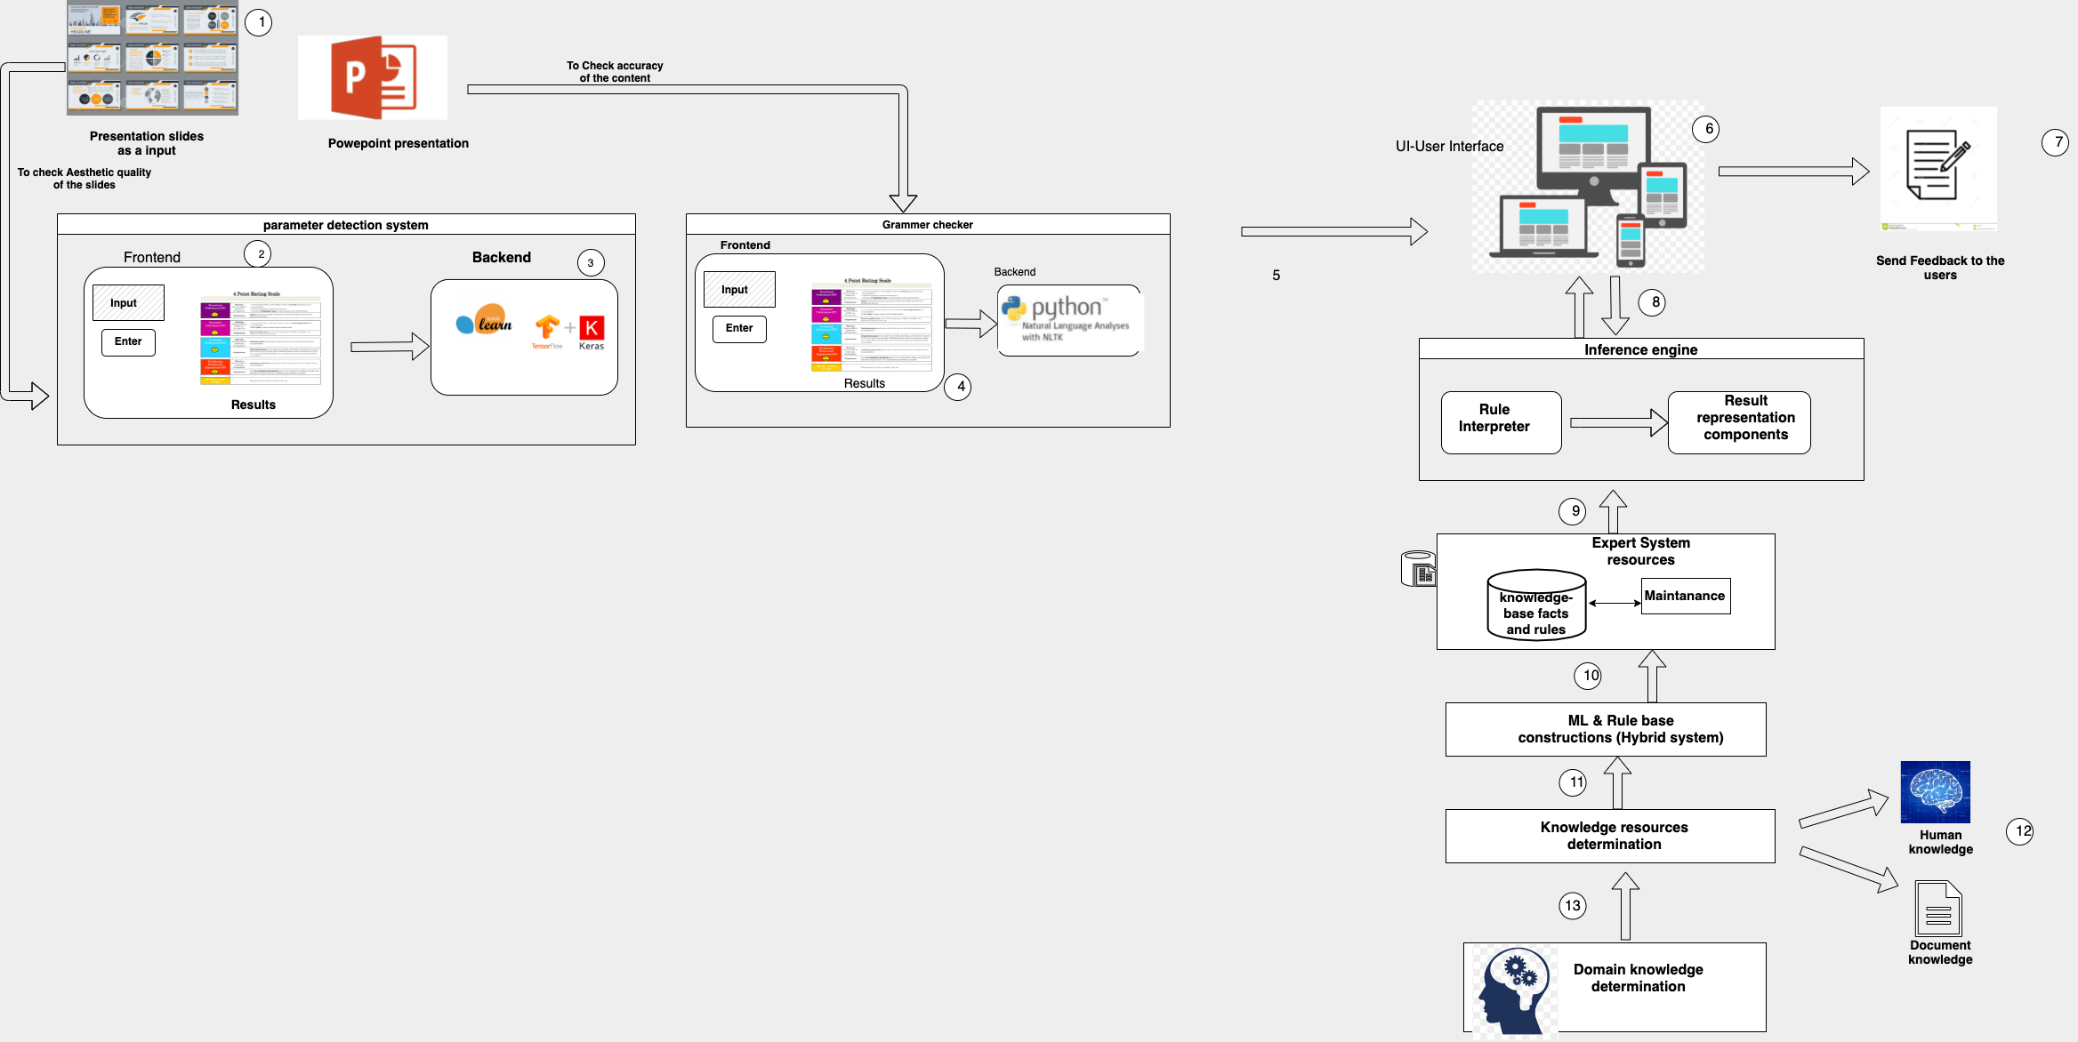
SYSTEM DIAGRAM
IT17535090 | Wedage C.V. | 21_22-J 02

Slide 55

TOOLS & TECHNOLOGIES
IT17535090 | Wedage C.V. | 21_22-J 02

Slide 56
FUNCTIONAL REQUIREMENTS
NON-FUNCTIONAL REQUIREMENTS
Obtain a presentation slide to get aesthetic analysis.
Received final feedback (output) for the uploaded presentation and slides.
Performance
Correctness
Availability
IT17535090 | Wedage C.V. | 21_22-J 02

Slide 57
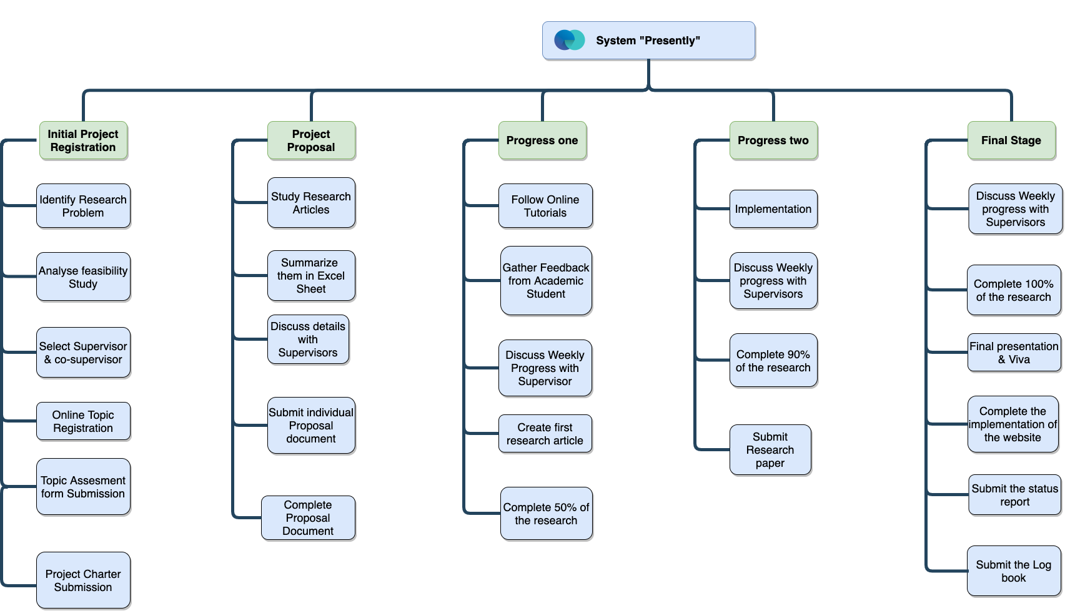
WORK BREAKDOWN CHART
IT17535090 | Wedage C.V. | 21_22-J 02

Slide 58
REFERENCES
[1] Deng, Y.; Loy, C.C.; Tang, X. Image aesthetic assessment: An experimental survey. IEEE Signal Process. Mag. 2017, 34, 80–106. [CrossRef]
[2] Le, Q.-T., Ladret, P., Nguyen, H.-T., & Caplier, A. (2020). Image Aesthetic Assessment Based on Image Classification and Region Segmentation. Journal of Imaging, 7(1), 3. https://doi.org/10.3390/jimaging7010003
[3] Aydin, T.O.; Smolic, A.; Gross, M. Automated aesthetic analysis of photographic images. IEEE Trans. Vis. Comput. Graph. 2015, 21, 31–42. [CrossRef]
[4] F. Sultana, A. Sufian and P. Dutta, "Advancements in Image Classification using Convolutional Neural Network," 2018 Fourth International Conference on Research in Computational Intelligence and Communication Networks (ICRCICN), 2018, pp. 122-129, doi: 10.1109/ICRCICN.2018.8718718.
﻿[5] Lu, X.; Lin, Z.; Jin, H.; Yang, J.; Wang, J.Z. Rating image aesthetics using deep learning. IEEE Trans. Multimed. 2015, 17, 2021–2034. [CrossRef]
﻿[6] Li, X., Li, X., Zhang, G., & Zhang, X. (2020). A Novel Feature Fusion Method for Computing Image Aesthetic Quality. IEEE Access, 8, 63043–63054. https://doi.org/10.1109/ACCESS.2020.2983725
[7] Park, K., Chae, M., & Cho, J. H. (2021). Image pre-processing method of machine learning for edge detection with image signal processor enhancement. Micromachines, 12(1), 1–13. https://doi.org/10.3390/mi12010073
[8] Stahlberg, F., & Kumar, S. (2021). Synthetic Data Generation for Grammatical Error Correction with Tagged Corruption Models. http://arxiv.org/abs/2105.13318
﻿
﻿
IT17535090 | Wedage C.V. | 21_22-J 02

Slide 59
[9] Goldberg, Y. (2016). A primer on neural network models for natural language processing. Journal of Artificial Intelligence Research, 57, 345- 420.
[10] Chollampatt, S., & Ng, H. T. (2018). A multilayer convolutional encoder-decoder neural network for grammatical error correction. In Thirty-Second AAAI Conference on Artificial Intelligence.
[11] Awasthi, A., Sarawagi, S., Goyal, R., Ghosh, S., & Piratla, V. (2019). Parallel iterative edit models for local sequence transduction. arXiv preprint arXiv:1910.02893.
[12] Choe, Y. J., Ham, J., Park, K., & Yoon, Y. (2019). A neural grammatical error correction system built on better pre-training and sequential transfer learning. arXiv preprint arXiv:1907.01256
13] Grundkiewicz, R., Junczys-Dowmunt, M., & Heafield, K. (2019). Neural grammatical error correction systems with unsupervised pre-training on synthetic data. In Proceedings of the Fourteenth Workshop on Innovative Use of NLP for Building Educational Applications (pp. 252-263).
[14] Zhao, W., Wang, L., Shen, K., Jia, R., & Liu, J. (2019). Improving gram- matical error correction ﻿via pre-training a copy-augmented architecture with unlabeled data. arXiv preprint arXiv:1903.00138. [7] Lu, X.; Lin, Z.; Jin, H.; Yang, J.; Wang, J.Z. Rating image aesthetics using deep learning. IEEE Trans. Multimed. 2015, 17, 2021–2034. [CrossRef]
[15] Chollampatt, S., & Ng, H. T. (2018). A multilayer convolutional encoder-decoder neural network for grammatical error correction. 32nd AAAI Conference on Artificial Intelligence, AAAI 2018, 5755–5762.
[16] Náplava, J., & Straka[, M. (2019). Grammatical Error Correction in Low-Resource Scenarios. 346–356. https://doi.org/10.18653/v1/d19-5545
IT17535090 | Wedage C.V. | 21_22-J 02

Slide 60
[17] Chollampatt, S., & Ng, H. T. (2018). A multilayer convolutional encoder-decoder neural network for grammatical error correction. 32nd AAAI Conference on Artificial Intelligence, AAAI 2018, 5755–5762.
[18] Gupta, P. (2020). A context-sensitive real-time spell checker with language adaptability. Proceedings - 14th IEEE International Conference on Semantic Computing, ICSC 2020, 116–122. https://doi.org/10.1109/ICSC.2020.00023
﻿[19] P. Gupta, S. Shekhawat, and K. Kumar, “Unsupervised quality estimation without reference corpus for subtitle machine translation using word embeddings,” in 2019 IEEE 13th International Conference on Semantic Computing (ICSC), Jan 2019, pp. 32–38.
﻿[20] Lichtarge, J., Alberti, C., Kumar, S., Shazeer, N., Parmar, N., & Tong, S. (2019). Corpora generation for grammatical error correction. NAACL HLT 2019 - 2019 Conference of the North American Chapter of the Association for Computational Linguistics: Human Language Technologies - Proceedings of the Conference, 1, 3291–3301. https://doi.org/10.18653/v1/n19-1333
[21] Hao, S., & Hao, G. (2020). A Research on Online Grammar Checker System Based on Neural Network Model. Journal of Physics: Conference Series, 1651(1). https://doi.org/10.1088/1742-6596/1651/1/012135
IT17535090 | Wedage C.V. | 21_22-J 02

Slide 61
No | Assessment / Milestone | Start Date | End Date | 2021-2022
 |  |  |  | April | May | June | July | August | September | October | November | December | January | February | March | April | May
1 | Project discussion workshop | 23-Apr-21 | 23-Apr-21
2 | Topic evaluation | 15-May-21 | 30-Jul-21
2a | Select a topic | 15-May-21 | 20-May-20
2b | Select a supervisor | 20-May-21 | 23-May-21
2c | Topic Evaluation form submission | 23-May-21 | 25-Jun-21
2d | Project charter submission | 20-Jun-21 | 30-Jul-21
3 | Project proposal report | 15-Jun-21 | 10-Aug-21
3a | Create Project Proposal - individual | 15-Jun-21 | 15-Jul-21
3b | Create Project Proposal - group | 15-Jul-21 | 06-Aug-21
3c | Project proposal presentation | 01-Aug-21 | 10-Aug-21
4 | Develop the system | 06-Aug-21 | 20-Feb-22
4a | Identifying functions | 06-Aug-21 | 20-Aug-21
4b | Database designing | 20-Aug-21 | 12-Sep-21
4c | Implementation | 12-Sep-21 | 30-Dec-21
4d | Unit testing | 01-Jan-22 | 30-Jan-22
4e | Integration testing | 30-Jan-22 | 20-Feb-22
5 | Progress Presentation - I | 01-Jan-22 | 06-Jan-22
5a | Project Status document | 01-Jan-22 | 06-Jan-22
5b | Create presentation document | 01-Jan-22 | 06-Jan-22
5c | Progress Presentation – I (50%) | 06-Jan-22 | 06-Jan-22
6 | Research Paper | 18-Oct-21 | 18-Mar-22
6a | Create the Research Paper | 18-Oct-21 | 18-Mar-22
7 | Progress Presentation - II | 22-Mar-22 | 29-Apr-22
7a | Create presentation document | 22-Mar-22 | 29-Apr-22
7b | Progress presentation – II (90%) | 29-Apr-22 | 29-Apr-22
8 | Final Report Submission | 14-Apr-22 | 14-May-22
8a | Final Report Submission | 14-Apr-22 | 14-May-22
8b | Application assessment | 01-May-22 | 14-May-22
8c | Project status document | 14-May-22 | 14-May-22
8d | Student logbook | 14-May-22 | 14-May-22
9 | Final Presentation & Viva | 14-Apr-22 | 25-May-22
9a | Create final presentation | 01-May-22 | 25-May-22
9b | Final report submission | 25-May-22 | 25-May-22
Gantt chart

Slide 62
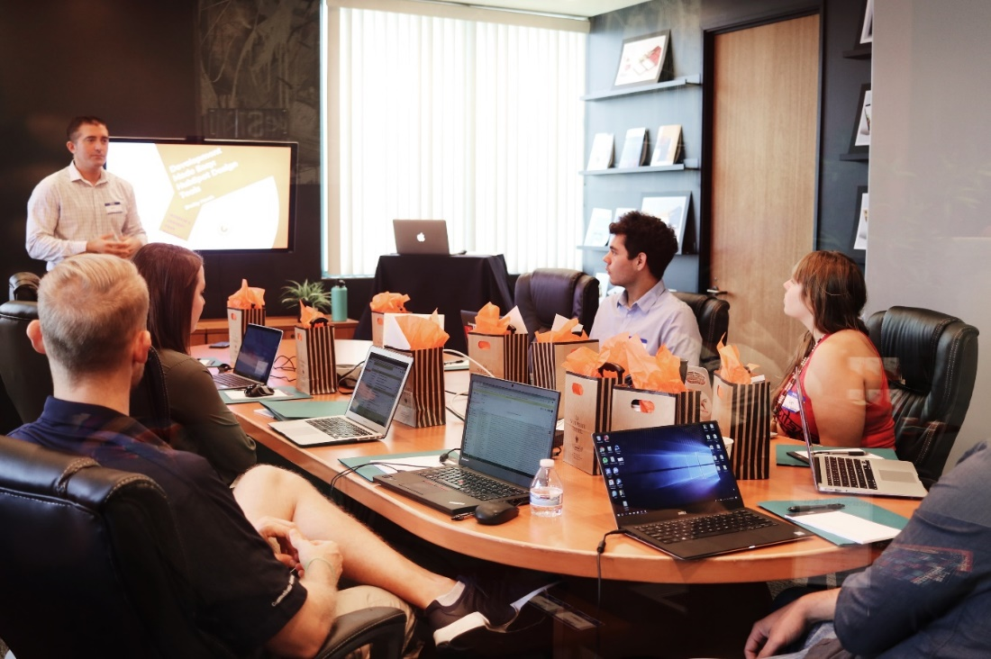
COMMERCIALIZATION
Target Audience
Employees in any industry
University Students and lecturers
Free Application
Free Access to the application
Advertisement
1 2
Stage Stage
Free Advertisement Fee

Slide 63
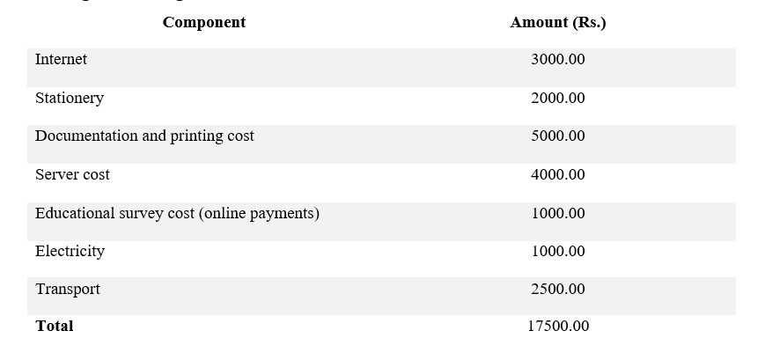
BUDGET

Slide 64

Thank You !
Team
21_22-J 02

